Slide 1
1Password Enterprise Password Manager
Presenter Name, Presenter Title
Date or location
Notes:
Intent:
Set the agenda together. This is a conversation, not a presentation.
Talk track (New business):
“I was catching up with [BDR] and they mentioned you’ve been running into [XYZ pain]. Before we jump in, I want to make sure we’re aligned.”
Talk track (Cross-sell):
“Last time we spoke, you mentioned unmanaged credentials showing up in a few places. I want to explore whether that’s isolated or something broader.”
Discovery questions:
“What’s top of mind for you right now?”
“What would make this call useful for you?”
Goal of the slide:
Agree on what problem you are solving today.

Slide 2


Work happens
from anywhere.
On any device, in any app, at any time.
Apps, people, devices, and AI now drive how work gets done.
Notes:
Intent:
Create inevitability. This is not a tooling issue, it’s a structural shift.
Talk track:
“The reason [XYZ pain] is so hard to solve is because the way we access work has fundamentally changed.”
SaaS explosion
Hybrid work
AI acceleration
Discovery questions:
“How has hybrid work changed access?”
“Are employees experimenting with AI tools today?”
“How has AI changed your IT or security policies?”
“Are you more concerned now than you were a year ago?”
Goal:
Get agreement on this statement: “Work today is very different than it used to be.”
MEDDPICC checklist
P: Do they agree work has fundamentally changed?
I: Do they acknowledge new risk from AI or decentralization?
Do not advance if they treat this as theoretical.

Slide 3







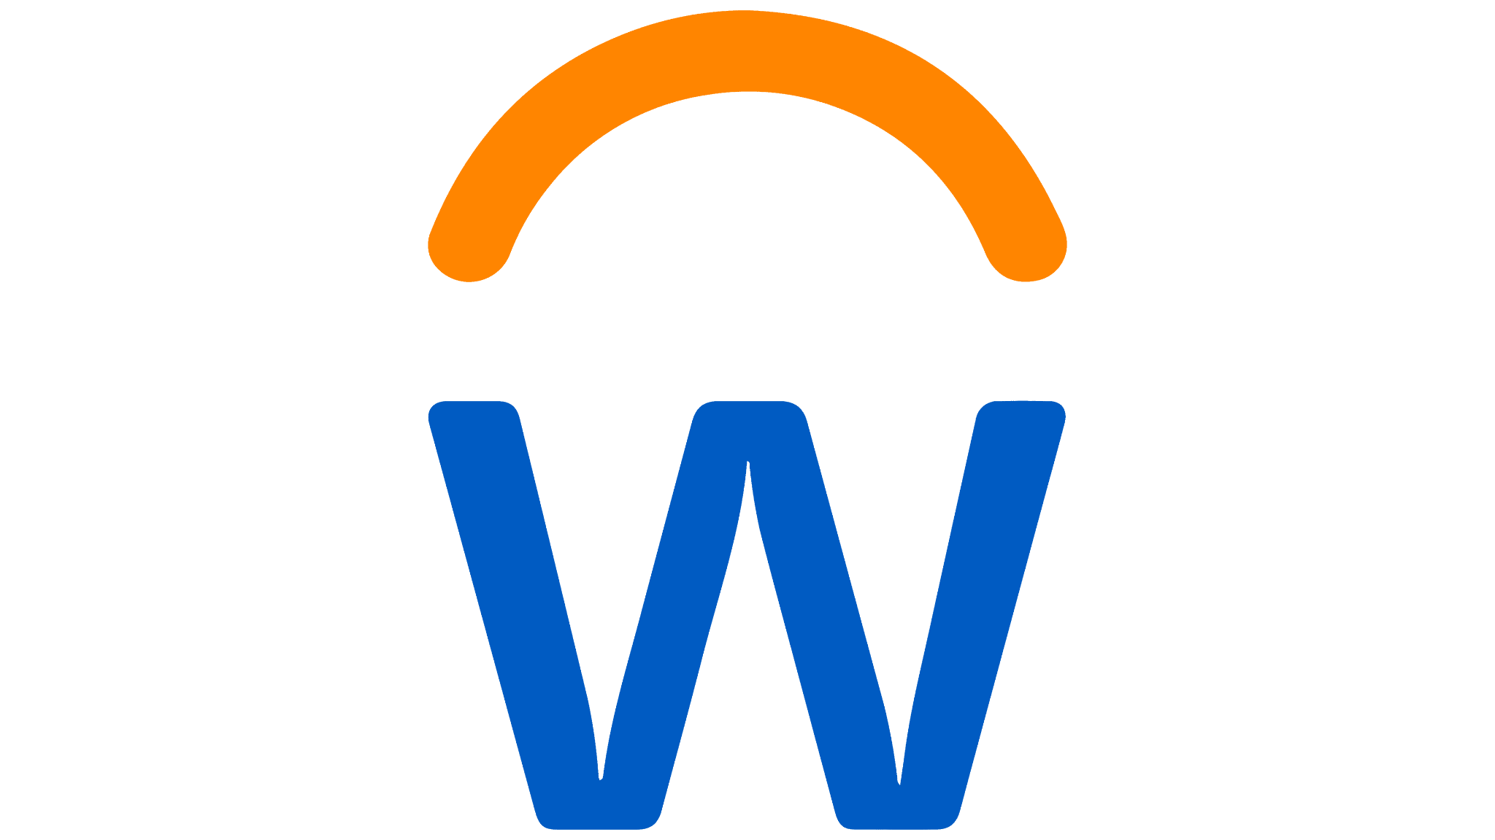

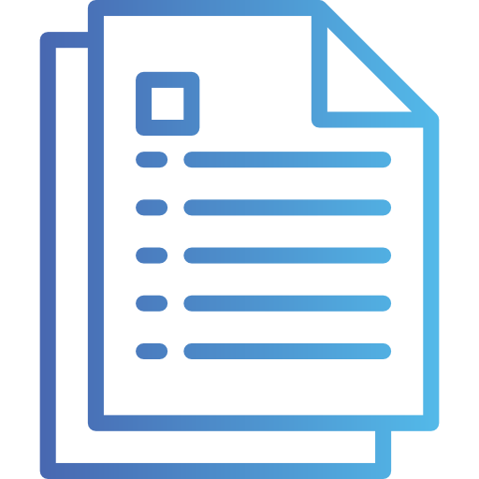
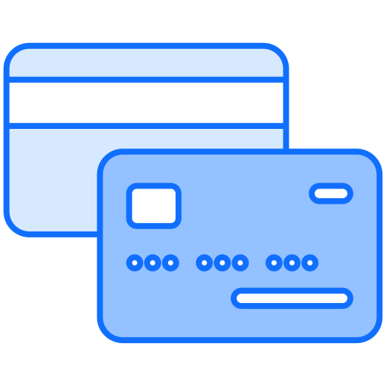


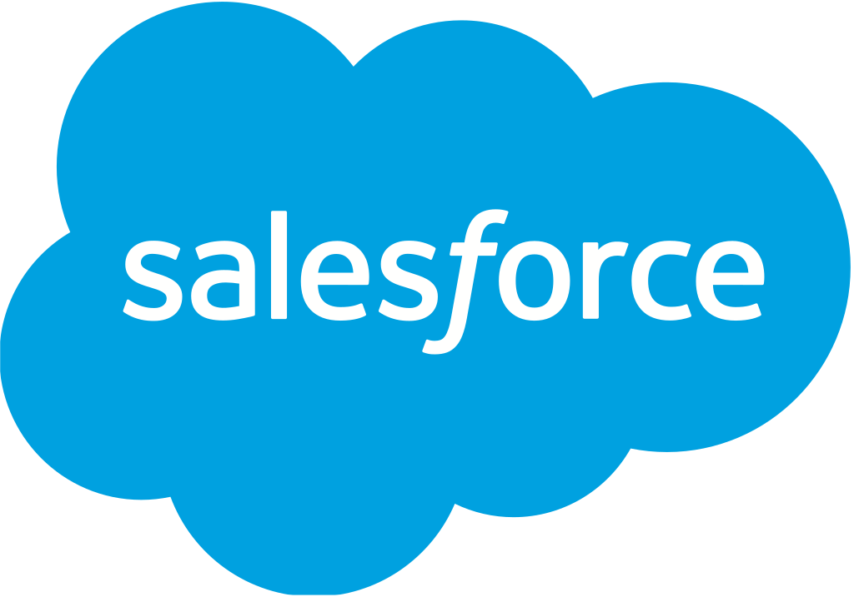



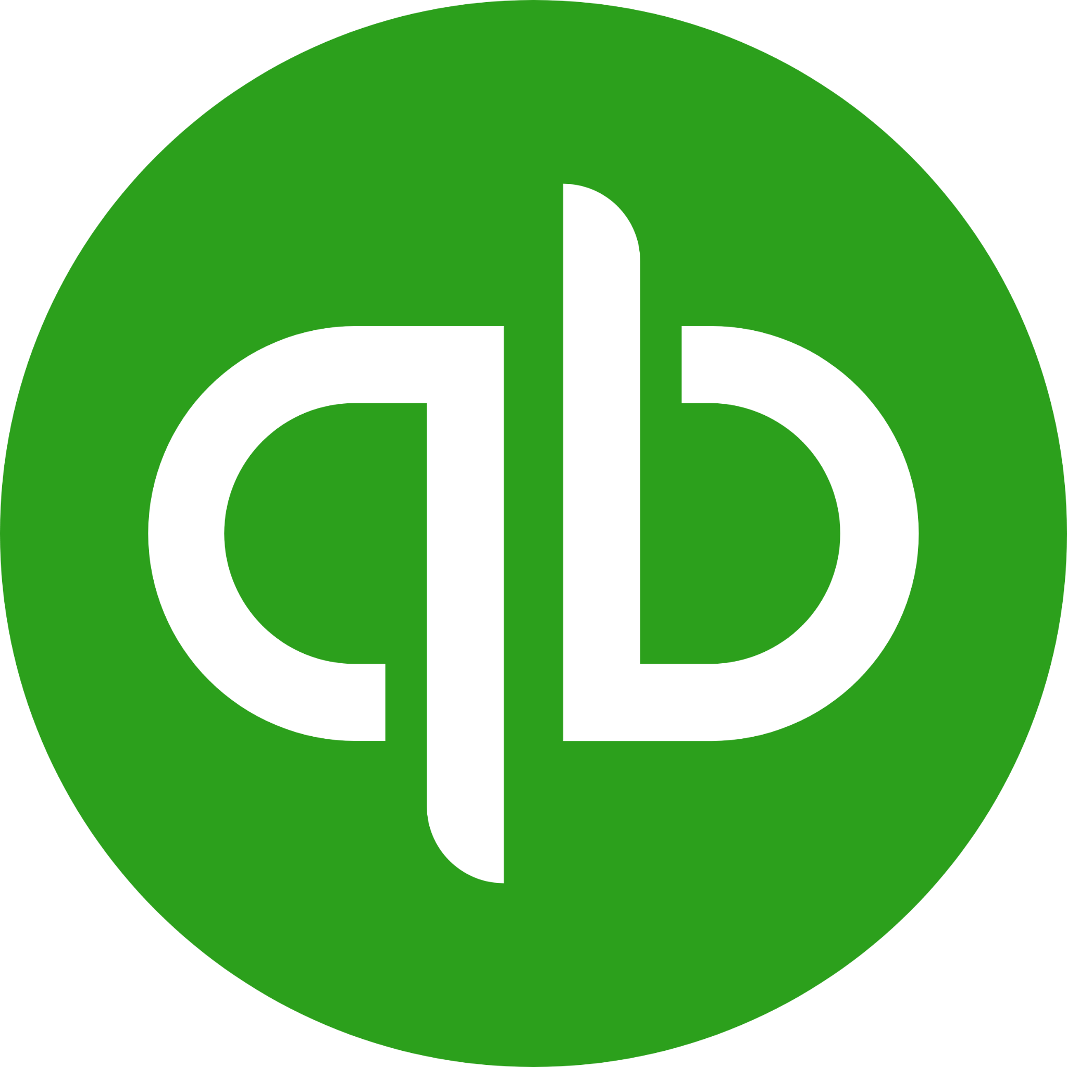





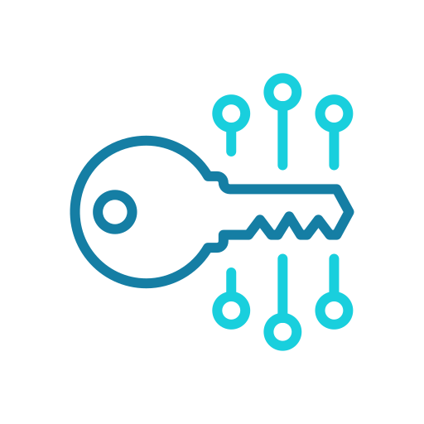

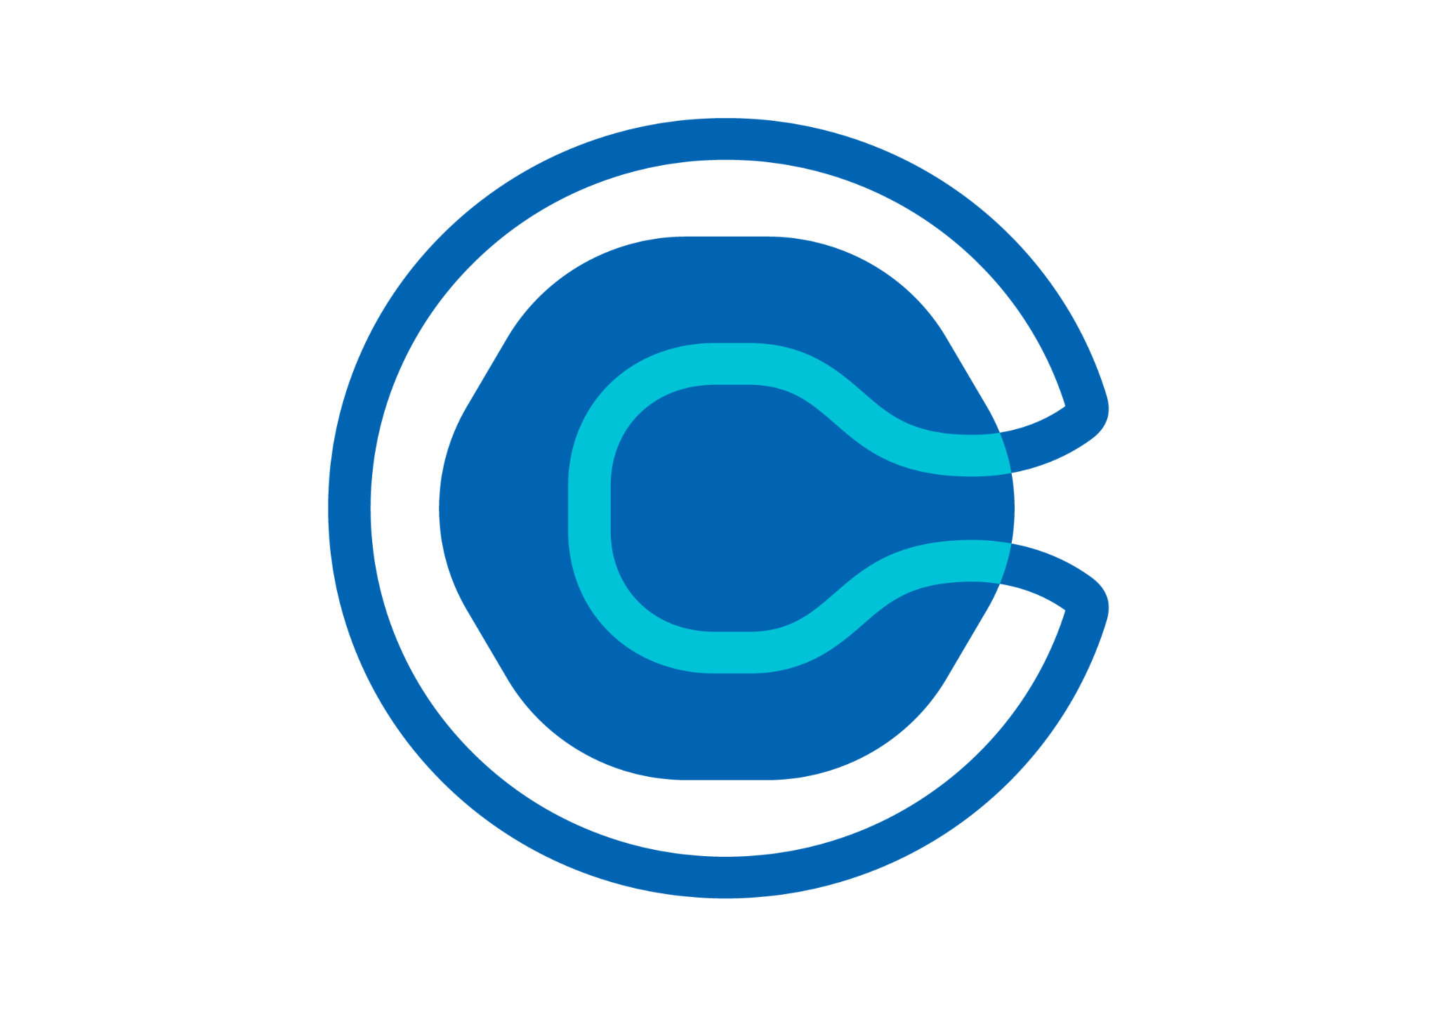


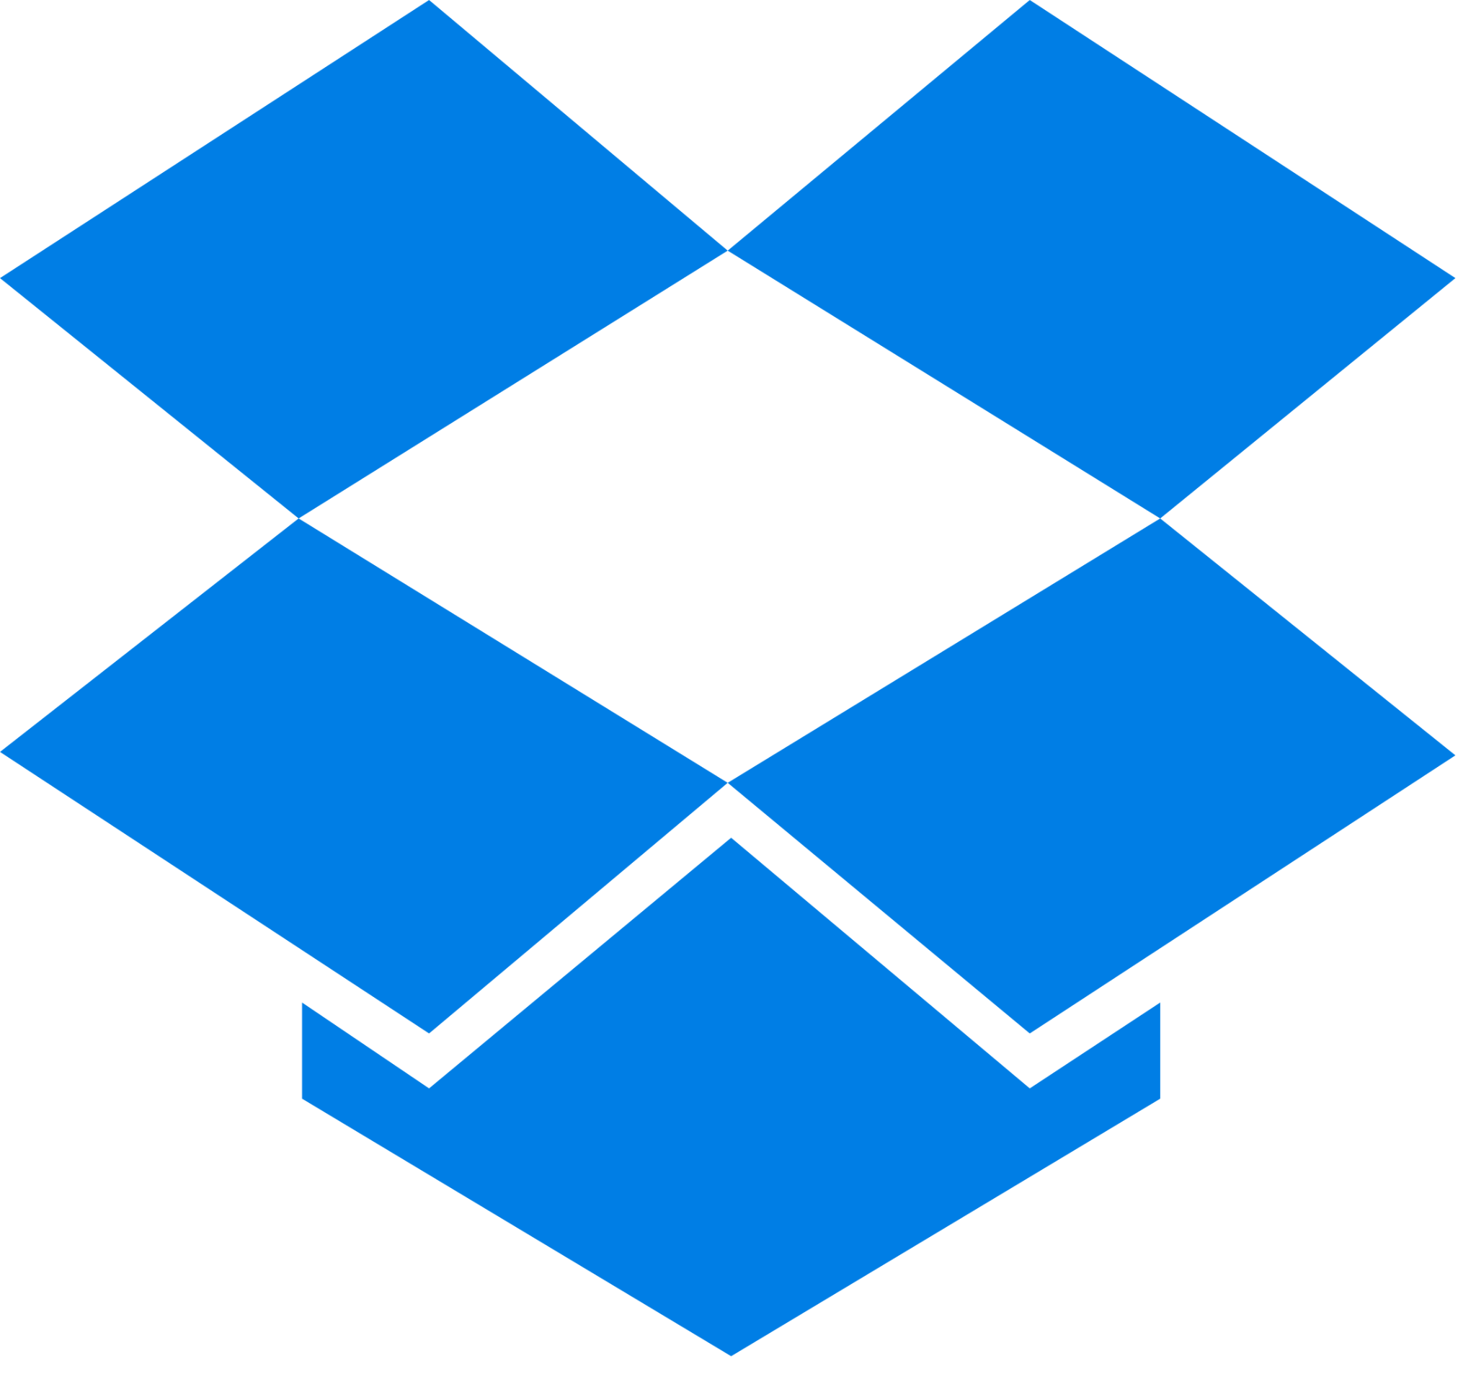
What’s being
shared anyways
What SSO protects
What’s left out
.env
Apps that don’t support SSO
Apps that are
too expensive to federate
Apps spun up without IT
Notes:
This is the most important slide in the deck.
Intent:
Expose their environment. This is where MEDDPICC really starts.
Anchor line (use verbatim):
“Most companies we work with are quite mature with SSO and IAM. Where things start to break isn’t what those systems were designed for. It’s everything that doesn’t sit cleanly behind them.”
Discovery questions:
“Roughly what percentage of apps are behind SSO?”
“What tends to fall outside? Vendors? Marketing tools? Legacy apps?”
“When SSO isn’t an option, where do credentials live?”
Branching questions (this is where multi-threading begins):
Marketing:
“Do you have a marketing team?”
“How are logins for Instagram, YouTube, ad platforms shared today?”
Developers:
“Do you have internal developers?”
“Where are API keys, SSH keys, or AI secrets stored?”
“Is PAM used? Who is it for?”
Did you know 1Password offers secrets management today with Dev tools that are included in EPM? Is there someone on your team that would benefit from seeing some of these dev tools in action?
“Where are non-privileged secrets stored today?”
“Are teams building AI workflows in-house?”
Security + IT:
“Who owns access outside SSO today?”
“How do you know what to investigate during an incident?”
“What breaks when someone leaves?”
MEDDPICC checklist
P: Blind spots acknowledged
I: Investigation or audit pain emerges
Goal:
They start saying things like:
“It depends on the team”
“We don’t really know”
“That’s handled outside IT”
I wonder if there’s someone from [xxx team] that might benefit from a conversation to see how we could help alleviate some of their pain points you mentioned. Someone we should connect with to understand if maybe there’s an opportunity for 1Password to help them.
That is your signal that this is bigger than Security or IT alone.
MEDDPICC checklist:
P: They admit gaps
I: They say “it depends” or “we don’t really know”
C: PAM/SSO limits are exposed

Slide 4
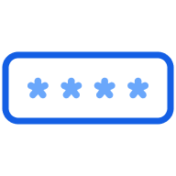
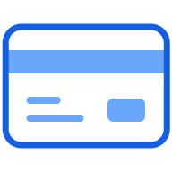
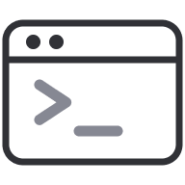

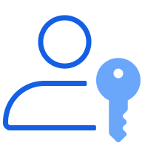

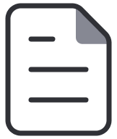

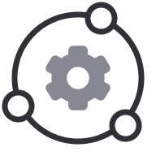





Our foundation is securing passwords and secrets
Enterprise Password Manager is the most secure vault for every credential — human and machine
People
Developers
Helps the business move faster
Save 1,400 hours a year by removing login friction.
Accelerates developer productivity
Thousands of hours saved with automated access and shared vaults.
Saves time for IT
Up to 70% fewer password resets.
Strengthens security posture
Reduce breach risk and avoid the $4.5M average cost of a credential-based attack.
Passwords
Payments
SSH keys
API keys
Passkeys
Private data
.env file
Security & Compliance
AI & Automation
SIEM integrations
Secrets sync
Breach alerts
Model Context Protocol
Auditing and Logging
Agentic Identities
Source: Forrester TEI Report, 1Password Business
PRIVATE AND CONFIDENTIAL
Notes:
Intent:
Credibility + scope. Not a product pitch.
Talk track (short):
“Just to give context on who we are and why companies bring us in at this stage.
Most of our customers already have SSO and PAM. Where they struggle is everything outside those systems: shared credentials, vendor access, service accounts, automation, and now AI workflows.
1Password sits in that gap. We extend identity and access control to the last mile, where credentials are actually used. These conversations often start with Security but quickly involve IT, Audit, Finance, and the business because the reality is when this problem is solved in pockets, risk and cost don’t really go down—they just move around. And we see impacts with this tool across this business - IT teams of course save time because their password reset tickets go down, but we also see productivity gains for employees and developers who can integrate 1Password into their existing workflows to remain secure without impacting innovation.
We often say, SSO secures the front door. PAM secures the server room. Most credential abuse starts in the hallways.”
Goal:
Reframe the problem as wall-to-wall or nothing.
Longer talk track
“Just to give a bit of context on who we are and why companies bring us in at this stage—
1Password works with over 180,000 businesses, including some of the most security-conscious organizations in the world. What they have in common isn’t that they lack SSO or PAM—most of them are quite mature there.
Where they struggle is everything that doesn’t sit cleanly behind those systems: apps without SSO, shared credentials, vendor access, service accounts, and the human behaviors that identity tools don’t fully control.
1Password sits in that gap. We help organizations extend identity and access controls to the last mile—giving security visibility and control over credentials that otherwise remain unmanaged in the age of AI, while making it easier for employees to do the right thing by default.
That’s why these conversations often start with Security but quickly involve IT, Audit, Finance, and the business. When this problem is solved in pockets, risk and cost don’t really go down—they just move around. And we see impacts with this tool across this business - IT teams of course save time because their password reset tickets go down, but we also see productivity gains for employees and developers who can integrate 1Password into their existing workflows to remain secure without impacting innovation.
Our goal in conversations like this isn’t to push a tool, but to determine whether this is actually a wall-to-wall issue for you, or something smaller. Either outcome is fine—we just want to be honest about the scope.
MEDDPICC checklist
C: They see EPM as complementary, not redundant

Slide 5
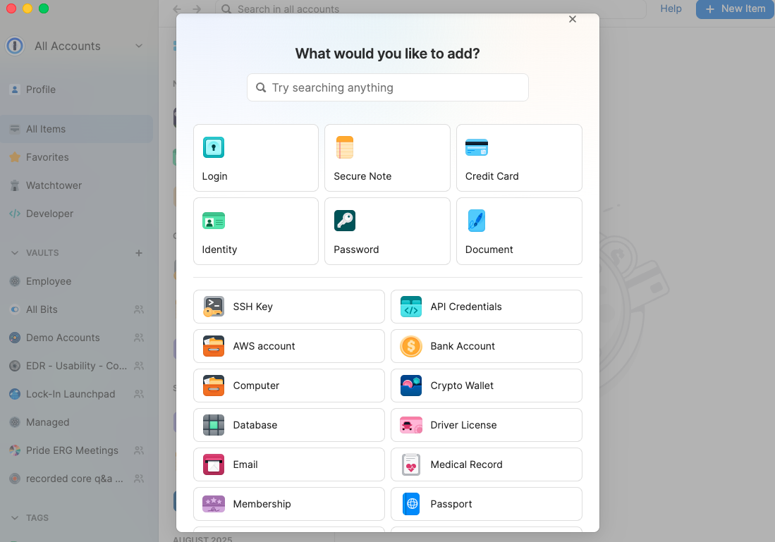
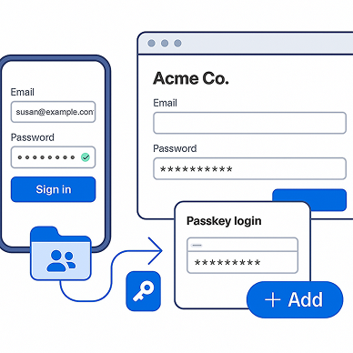
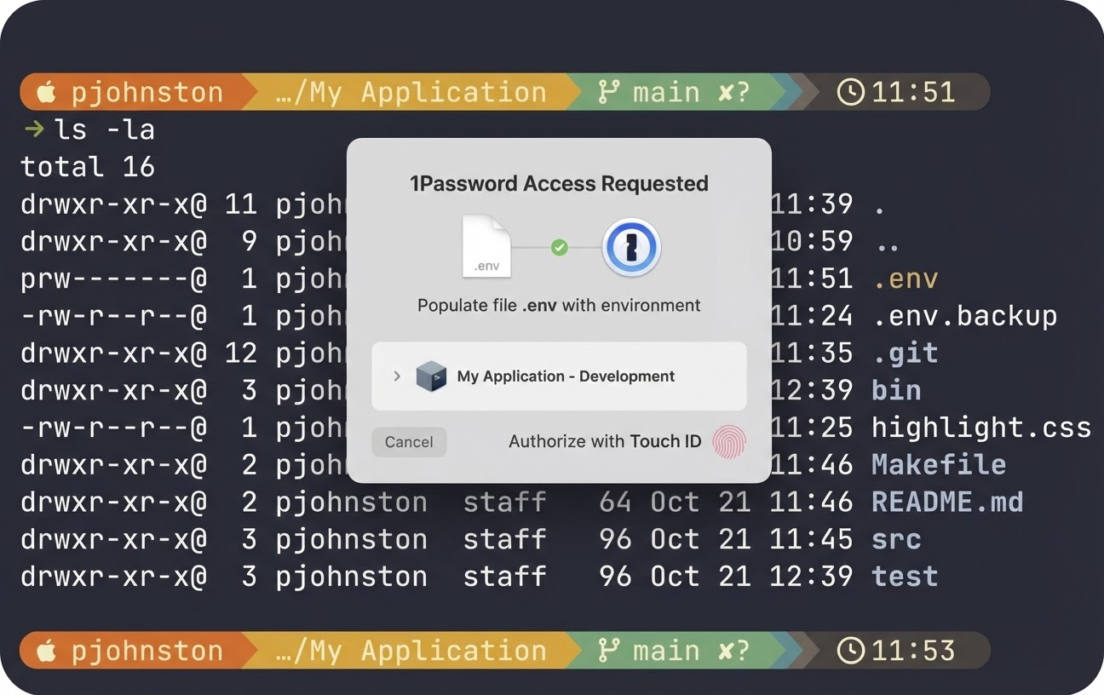
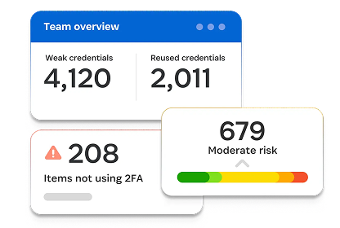
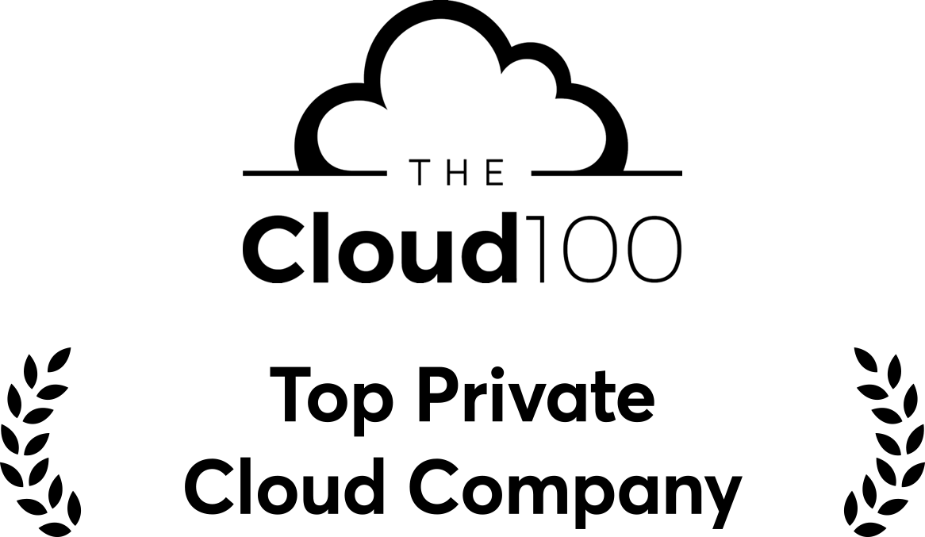
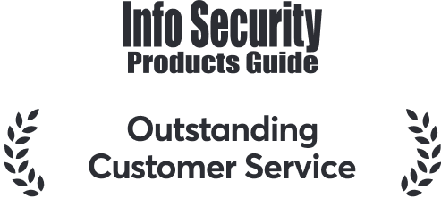
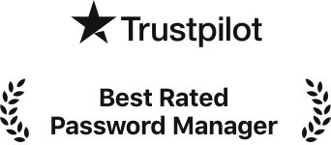
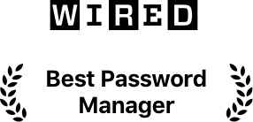
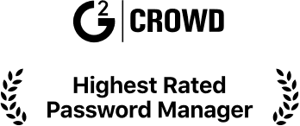
Secure access everywhere work happens with 1Password
PRIVATE AND CONFIDENTIAL
Protect credentials for people, machines, and AI beyond traditional identity systems
See and secure what SSO can’t
Move fast without identity risk
Control credentials, not workflows
Notes:
Intent:
Summarize the impact and tee up the next step.
Reframed talk track:
“When organizations deploy 1Password wall-to-wall, three things consistently happen.”
Visibility
Speed without risk
Fewer blind spots
“The question now isn’t whether this can help. It’s how broad the problem really is.”
Multi-threading ask (use verbatim):
“To see whether this warrants a wall-to-wall approach, it would help to validate this with a couple of other teams. Who else feels some of these pains we’ve chatted about?
Good signals:
Marketing
Engineering
IT Ops
Audit or Compliance
If Audit comes up, urgency increases immediately.
MEDDPICC checklist:
M: Business impact understood
E: Agreement to multi-thread

Slide 6


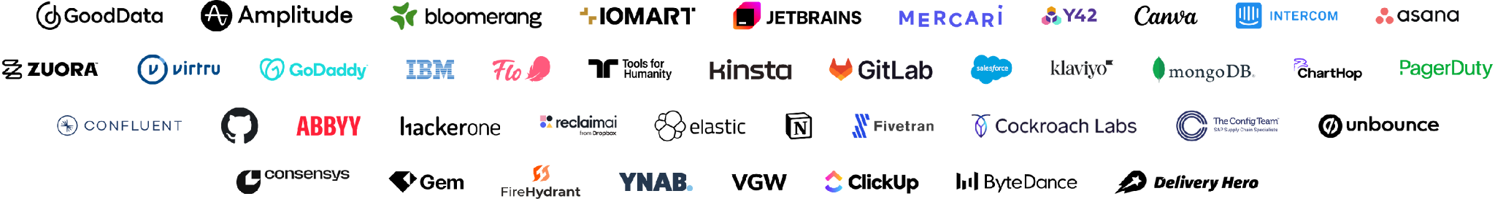

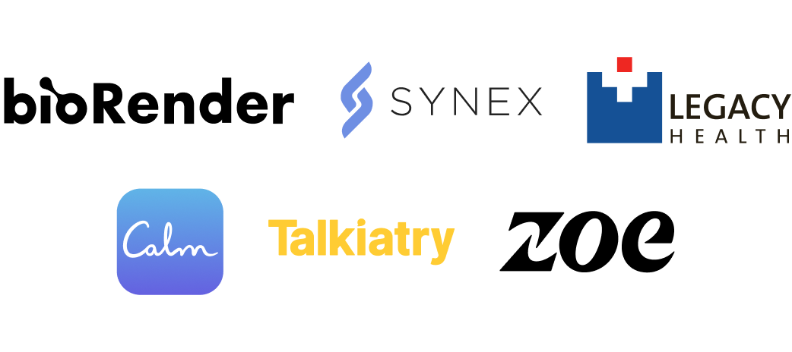

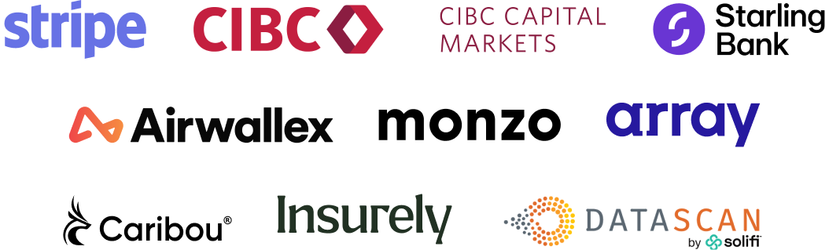
Trusted by over 200k businesses around the world
1Password secures every sign in, to every app, from every device
SaaS & Cloud Software
Education
Financial Services
Healthcare & Life Sciences
Notes:
Intent:
Reduce perceived risk of expanding scope.
Talk track:
“When we say we’re trusted, we mean it literally. Over 180,000 organizations rely on 1Password across industries and regions.”
Then only mention examples relevant to the prospect’s industry:
Pick one relevant logo
Tie it to their use case, not generic trust
Goal:
Make it safe for the buyer to say: “Okay, others like us have solved this.”
MEDDPICC checklist:
D: Reduced perceived risk
E: Buyer feels safe expanding scope
Examples:
And when we say we are a trusted, we mean it literally. More than 180,000 businesses across industries, geographies, and sizes rely on 1Password to protect what matters most: identity.
In SaaS and cloud-first companies, like GitLab, MongoDB, and Canva, we’re part of the developer workflow — protecting every API key, token, and credential that powers modern software.
In financial services, from Stripe to CIBC, we help secure every customer interaction, every compliance workflow, and every human or machine identity behind it.
In healthcare and life sciences, organizations like bioRender and ZOE trust us to safeguard sensitive data while empowering innovation that improves lives.
And in education, universities like Harvard, Duke, and the University of Toronto use 1Password to protect research data, faculty access, and student privacy.

Slide 7


Industry
Products
Software
EPM
1Password has turned security into a growth enabler. We can integrate new teams and systems quickly while maintaining
the highest security standards and enabling exceptional creative experiences for
our customers.”
Kane Narraway
Head of Enterprise Security at Canva
Strengthened sign-ins and centralized credential management, establishing a secure foundation for growth
Enabled secure, same-day onboarding for global employees,
eliminating downtime and enhancing security
Boosted engineering productivity in developer workflows via
the 1Password CLI
Challenge
Solutions
Canva’s rapid global expansion and fivefold workforce growth created challenges in maintaining enterprise-level security. It needed to meet compliance demands, streamline onboarding, support developer efficiency, and secure shared accounts without disrupting services.
Canva uses 1Password Enterprise Password Manager to centralize credential management, enabling secure, same-day onboarding and global access. Developers streamline workflows via 1Password CLI, while 1Password Watchtower and 1Password Insights strengthen protection, compliance, and efficiency.
PRIVATE AND CONFIDENTIAL
Notes:
Intent:
Mirror their reality back to them.
Do not retell the case study
Highlight one before and one after
Talk track:
“Before 1Password, Canva was struggling to meet compliance demands, they couldn’t streamline onboarding, or support developer efficiency, and they had no way of securing shared accounts without disrupting services.
“After adopting 1Password, they were able to centralize credential management, enabling secure, same-day onboarding and global access. Developers streamline workflows via 1Password CLI, while 1Password Watchtower and 1Password Insights strengthen protection, compliance, and efficiency.
Discovery question:
“What part of that sounds familiar?”
Goal:
Self-identification.
MEDDPICC checklist
I: Emotional identification

Slide 8
Product Features

Slide 9
Protect credentials beyond the reach of SSO
PRIVATE AND CONFIDENTIAL

Slide 10
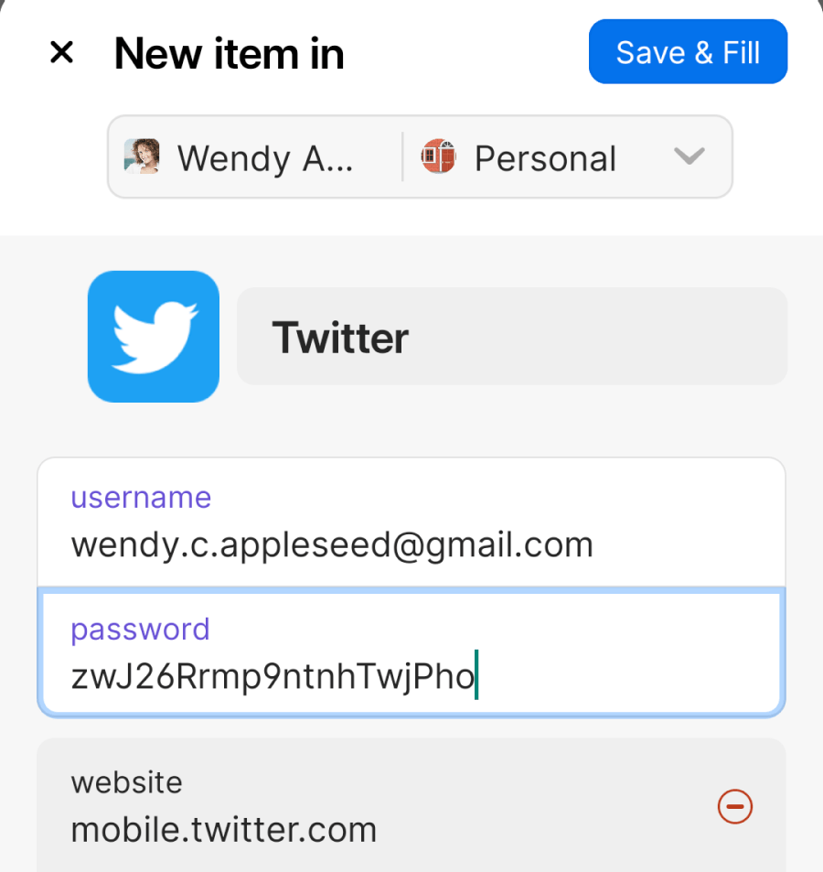
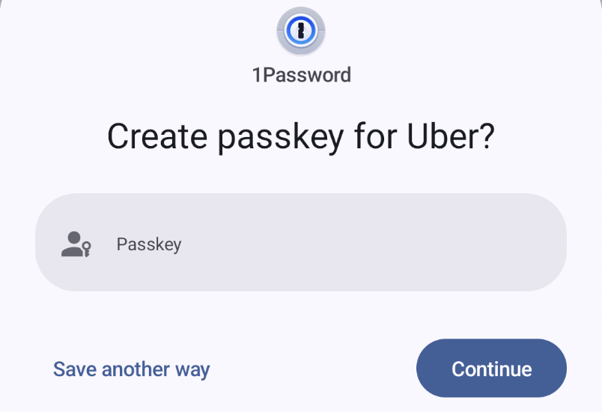
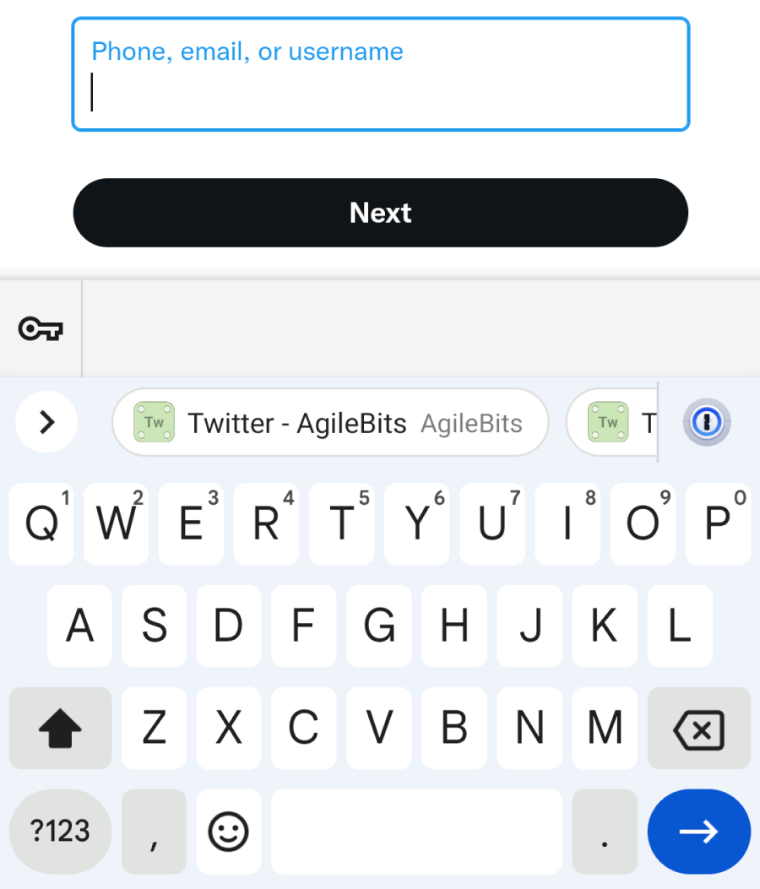
Create, save, and autofill both passwords and passkeys
PRIVATE AND CONFIDENTIAL

Slide 11
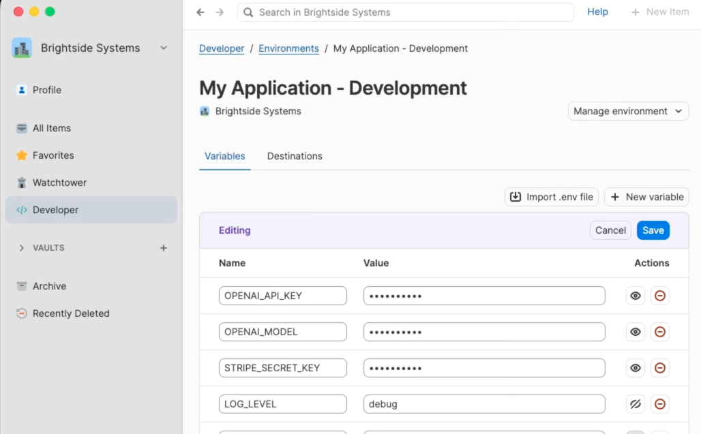
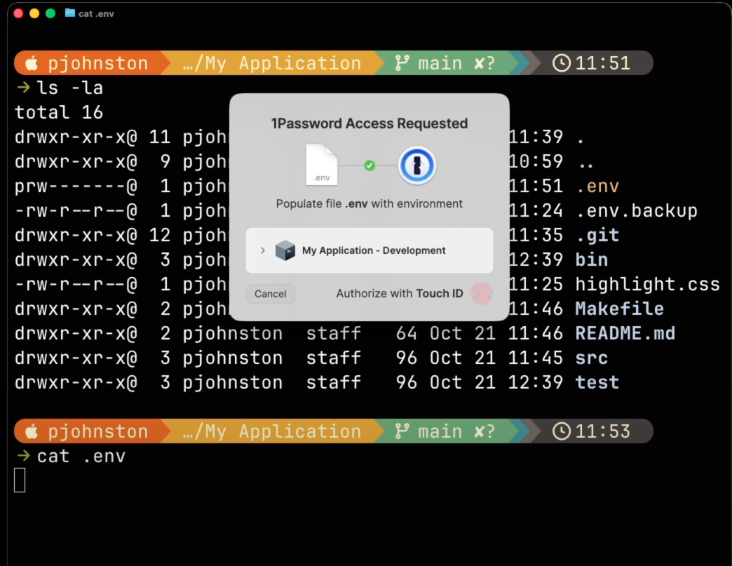
Eliminate hard-coded secrets in developer environments
PRIVATE AND CONFIDENTIAL

Slide 12
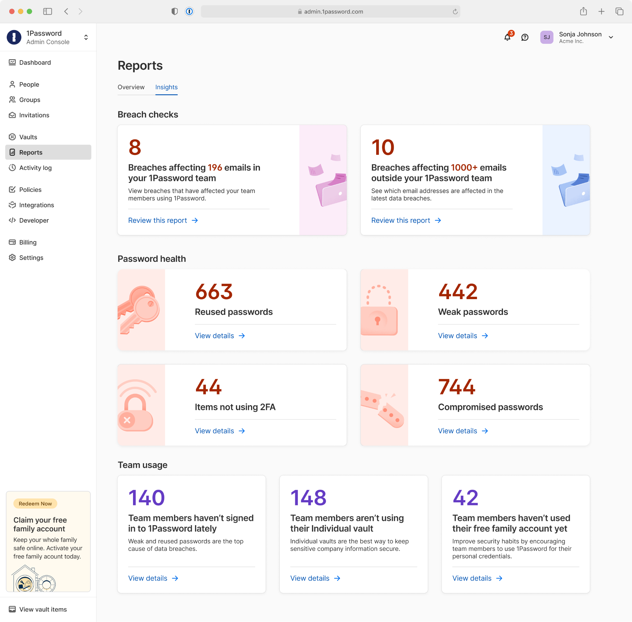
Real-time visibility into credential hygiene and risk
PRIVATE AND CONFIDENTIAL

Slide 13
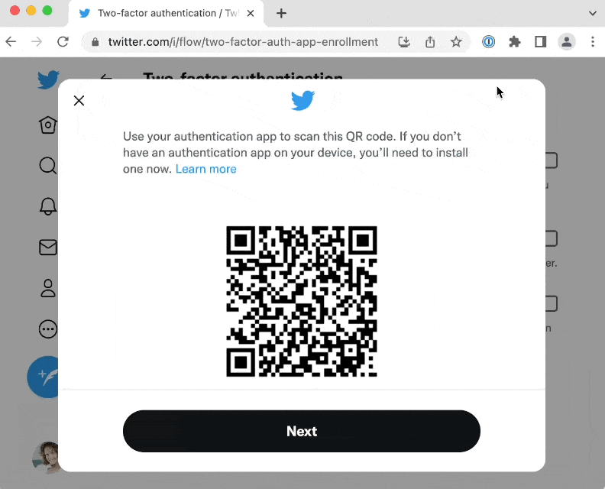
Improve MFA adoption with integrated one-time passwords
PRIVATE AND CONFIDENTIAL

Slide 14
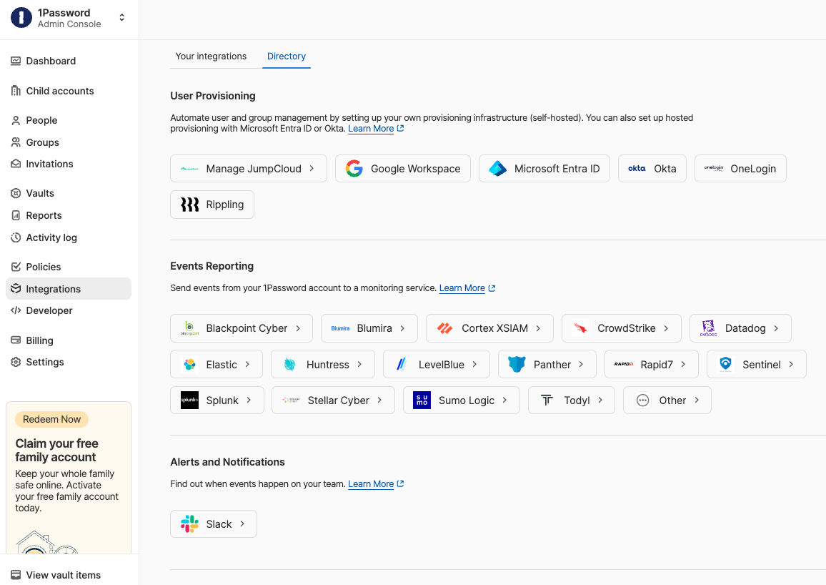
Integrate into existing tech stacks
PRIVATE AND CONFIDENTIAL

Slide 15
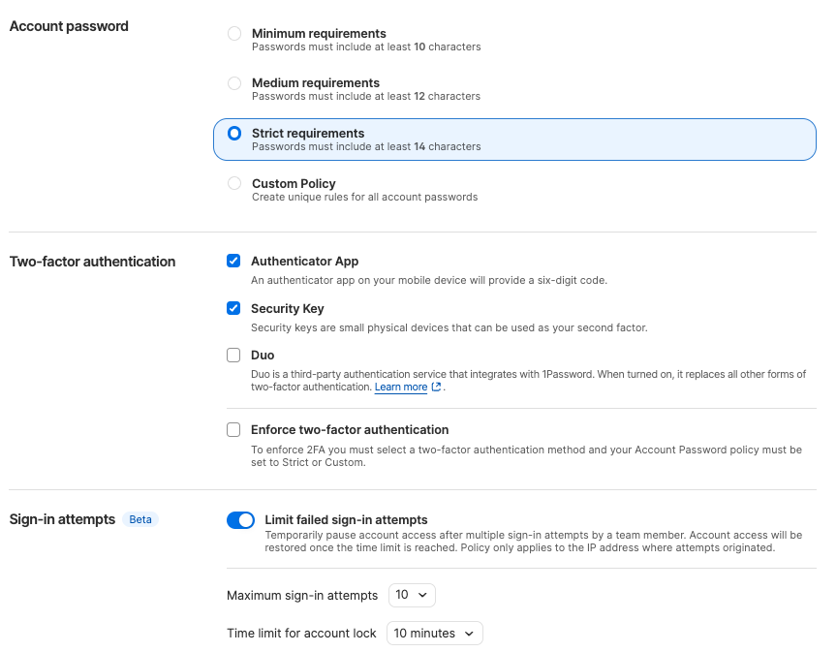
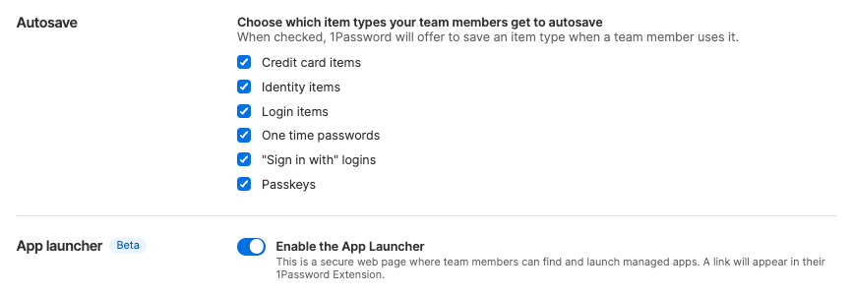
Enforce consistent credential policies across the organization
PRIVATE AND CONFIDENTIAL

Slide 16
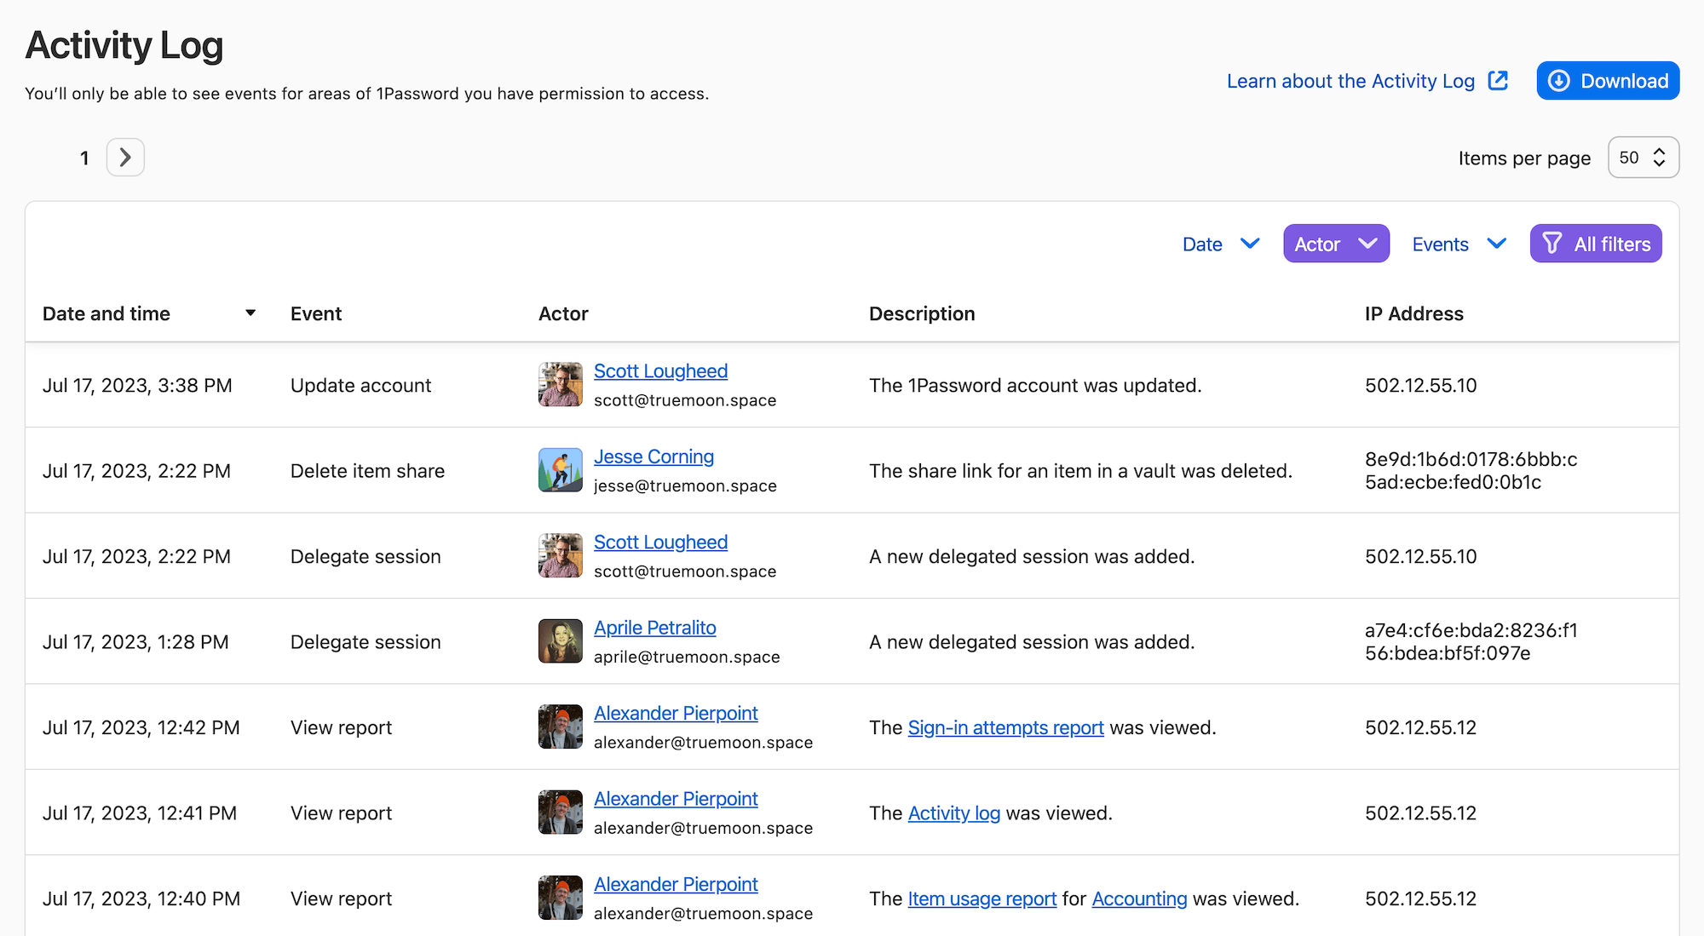
Prove compliance with complete audit visibility
PRIVATE AND CONFIDENTIAL

Slide 17
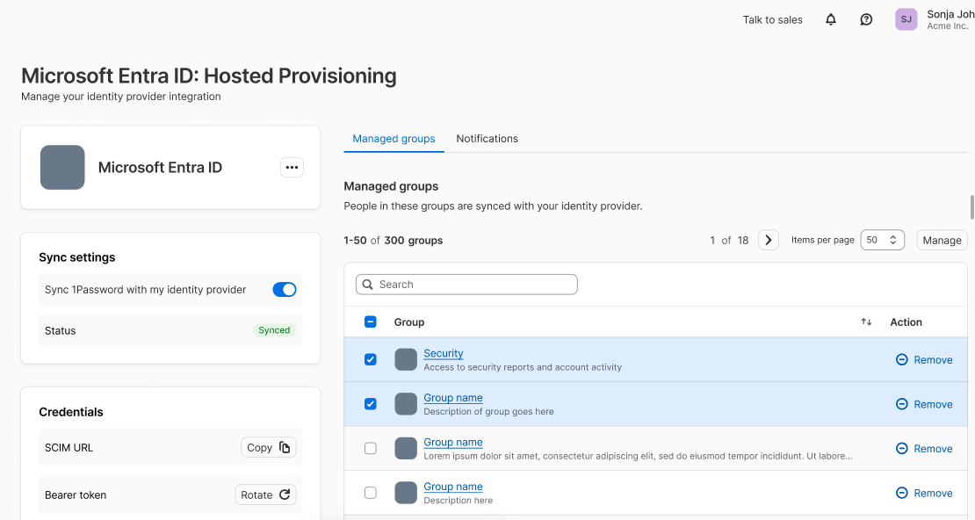
Automated provisioning powered by confidential computing
PRIVATE AND CONFIDENTIAL

Slide 18
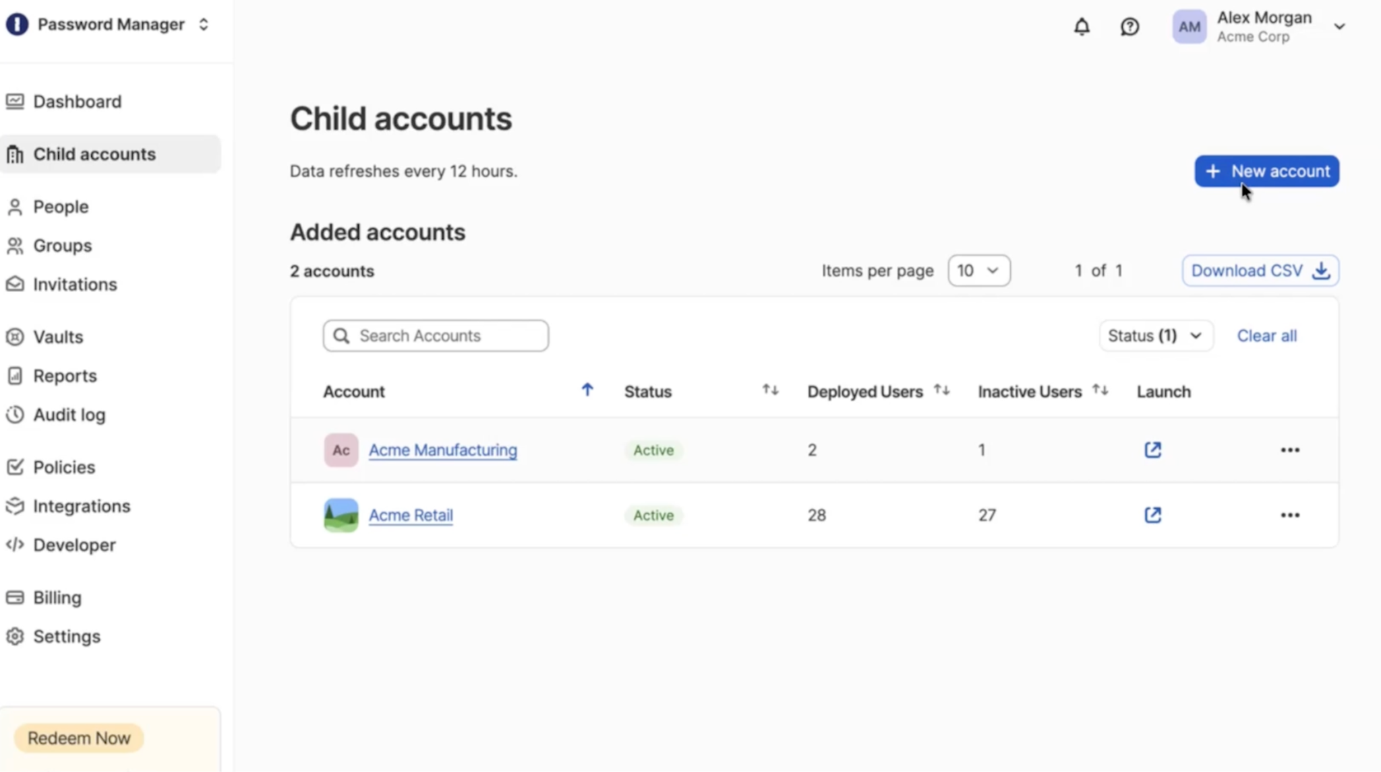
Centralized governance, distributed control with Multi-Tenancy
PRIVATE AND CONFIDENTIAL
Notes:
Big orgs often are faced with a difficult choice. Either one giant flat account that's easy to govern but ignores how they’re actually structured, or a bunch of separate accounts that fit the org but leave them no central control. Multi-tenancy ends that tradeoff. You get one parent account governing any number of child accounts under it, in your data region, with each account's data fully separated.
The structure maps to your business, by subsidiary, region, or unit, and each child gets a local admin who runs their own setup. So rollouts stop bottlenecking on one central team, which is usually the real reason wall-to-wall deployment stalls.
But because governance lives at the parent, that separation never costs you control. You build a policy template once and apply it across accounts, and per policy you decide mandatory or overridable. So your non-negotiables like MFA and account-password rules stay locked everywhere, while local settings stay flexible. And you keep one view across every account, deployment versus active usage in one place.
Net: structure that matches how you're built, central control your security team wants, and local autonomy that actually gets it deployed. That's how a stalled rollout goes wall-to-wall.

Slide 19
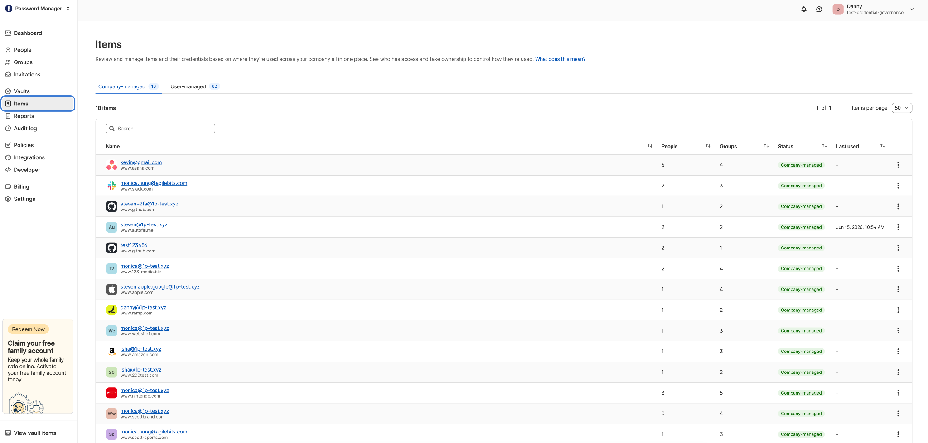
Discover, reclaim, and govern high-risk logins with Credential Governance
PRIVATE AND CONFIDENTIAL
Notes:
Big orgs often are faced with a difficult choice. Either one giant flat account that's easy to govern but ignores how they’re actually structured, or a bunch of separate accounts that fit the org but leave them no central control. Multi-tenancy ends that tradeoff. You get one parent account governing any number of child accounts under it, in your data region, with each account's data fully separated.
The structure maps to your business, by subsidiary, region, or unit, and each child gets a local admin who runs their own setup. So rollouts stop bottlenecking on one central team, which is usually the real reason wall-to-wall deployment stalls.
But because governance lives at the parent, that separation never costs you control. You build a policy template once and apply it across accounts, and per policy you decide mandatory or overridable. So your non-negotiables like MFA and account-password rules stay locked everywhere, while local settings stay flexible. And you keep one view across every account, deployment versus active usage in one place.
Net: structure that matches how you're built, central control your security team wants, and local autonomy that actually gets it deployed. That's how a stalled rollout goes wall-to-wall.

Slide 20
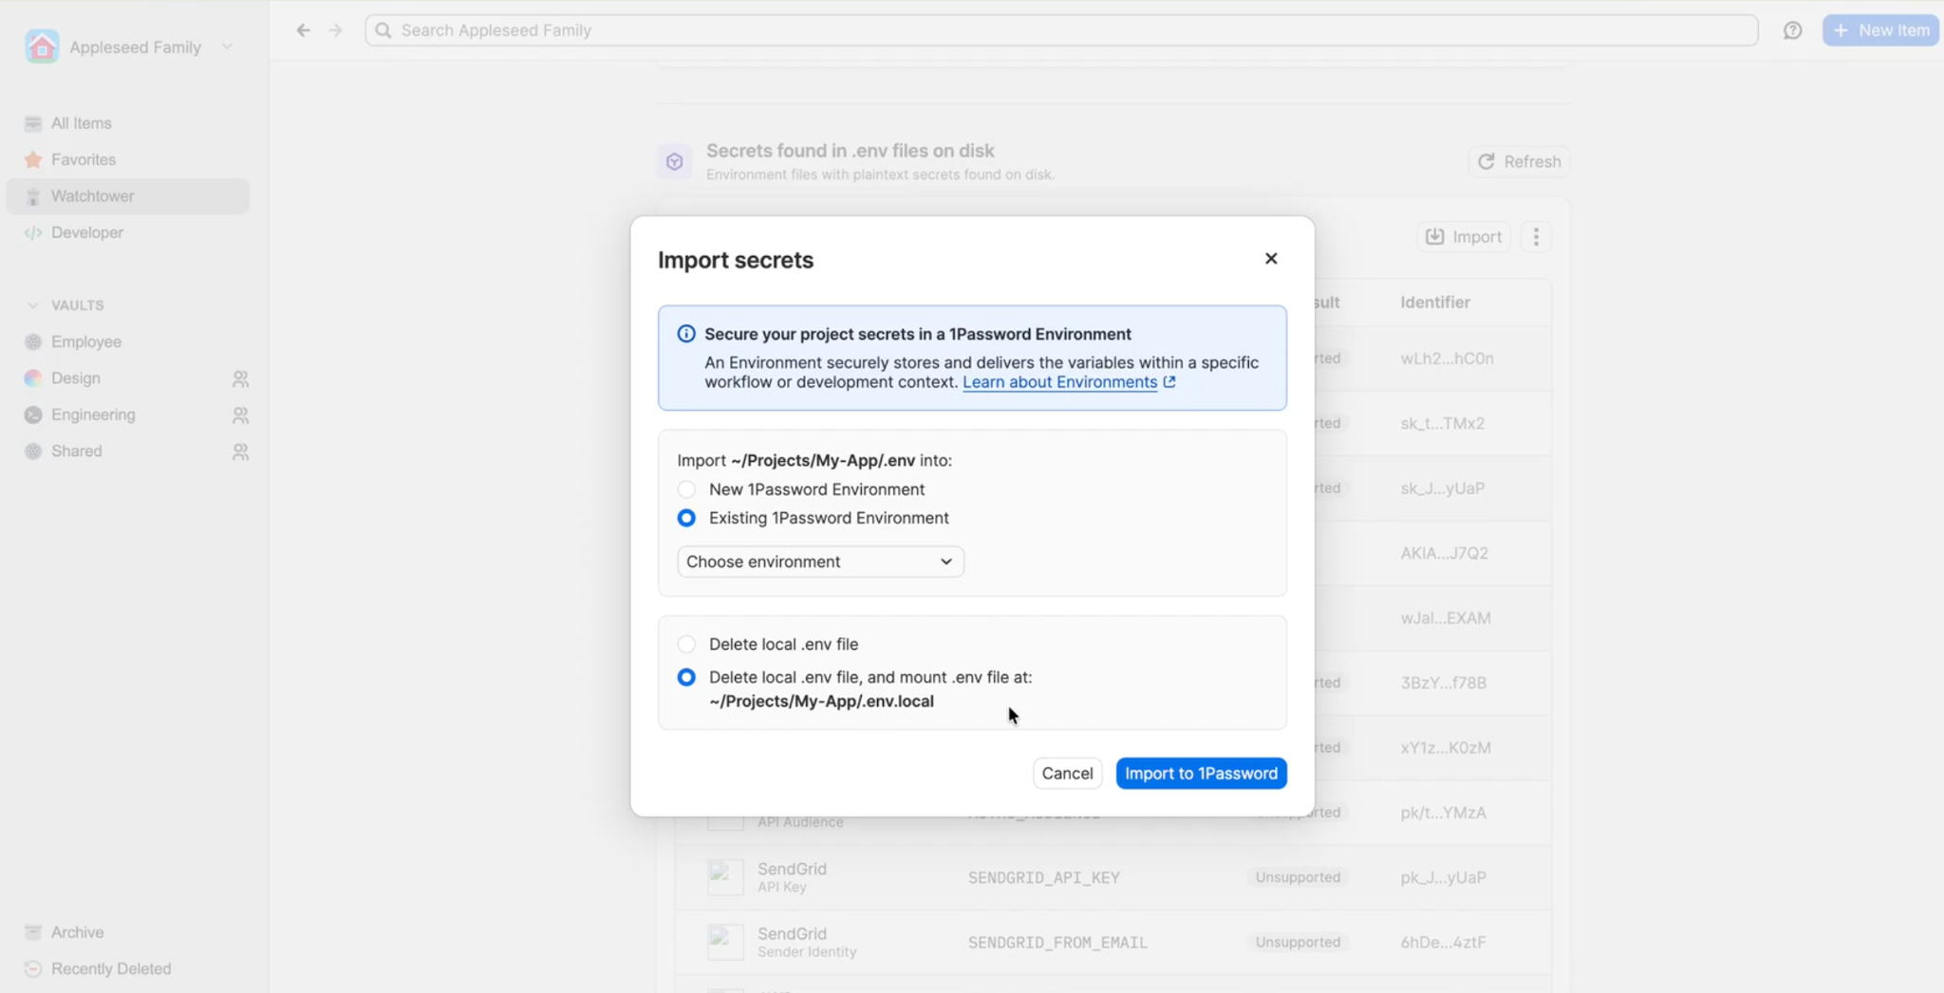
Get visibility into plaintext secrets across developer devices with Developer Watchtower
PRIVATE AND CONFIDENTIAL
Notes:
Big orgs often are faced with a difficult choice. Either one giant flat account that's easy to govern but ignores how they’re actually structured, or a bunch of separate accounts that fit the org but leave them no central control. Multi-tenancy ends that tradeoff. You get one parent account governing any number of child accounts under it, in your data region, with each account's data fully separated.
The structure maps to your business, by subsidiary, region, or unit, and each child gets a local admin who runs their own setup. So rollouts stop bottlenecking on one central team, which is usually the real reason wall-to-wall deployment stalls.
But because governance lives at the parent, that separation never costs you control. You build a policy template once and apply it across accounts, and per policy you decide mandatory or overridable. So your non-negotiables like MFA and account-password rules stay locked everywhere, while local settings stay flexible. And you keep one view across every account, deployment versus active usage in one place.
Net: structure that matches how you're built, central control your security team wants, and local autonomy that actually gets it deployed. That's how a stalled rollout goes wall-to-wall.

Slide 21
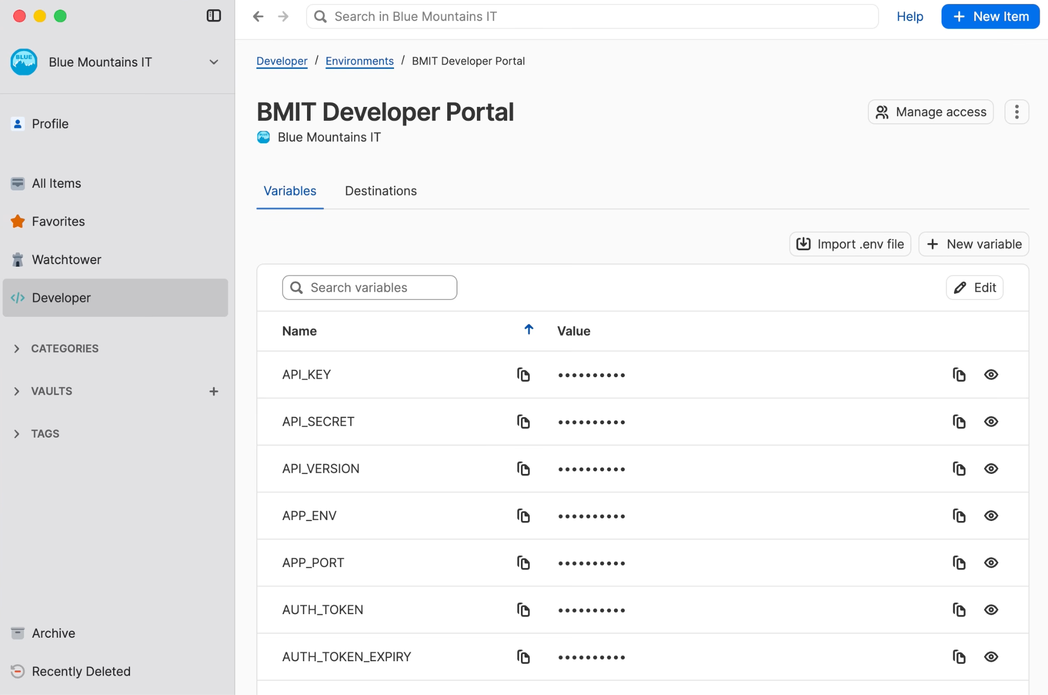
Provision secrets to humans, machines, and agents from a single source with Environments
PRIVATE AND CONFIDENTIAL
Notes:
Big orgs often are faced with a difficult choice. Either one giant flat account that's easy to govern but ignores how they’re actually structured, or a bunch of separate accounts that fit the org but leave them no central control. Multi-tenancy ends that tradeoff. You get one parent account governing any number of child accounts under it, in your data region, with each account's data fully separated.
The structure maps to your business, by subsidiary, region, or unit, and each child gets a local admin who runs their own setup. So rollouts stop bottlenecking on one central team, which is usually the real reason wall-to-wall deployment stalls.
But because governance lives at the parent, that separation never costs you control. You build a policy template once and apply it across accounts, and per policy you decide mandatory or overridable. So your non-negotiables like MFA and account-password rules stay locked everywhere, while local settings stay flexible. And you keep one view across every account, deployment versus active usage in one place.
Net: structure that matches how you're built, central control your security team wants, and local autonomy that actually gets it deployed. That's how a stalled rollout goes wall-to-wall.

Slide 22




Securing AI Development
Secrets Management
Inject credentials safely into CI/CD and runtime environments
1Password CLI
Access and manage secrets right from your terminal
Integrations
Connect with GitHub Actions, AWS, GCP, OpenAI, and more
1Password Environments
Securely manage and share .env files without changing your workflow

Slide 23
Tech + Security

Slide 24

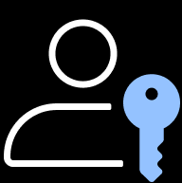

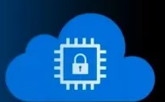
Two-Secret Key Derivation model
Data encrypted with Account Password and a device-generated Secret Key that never leaves the user’s device.
Security
isn’t just a feature
Zero knowledge that actually means zero access
Encryption and decryption happen only on trusted devices.
It’s our unique foundation
Confidential
computing
Protecting secrets even while they’re in use.
Notes:
1Password is one of the few password managers that uses confidential computing to protect cryptographic operations at runtime.
Sensitive operations run inside hardware-isolated secure enclaves, where memory is encrypted and inaccessible — even to the cloud provider or 1Password itself.
Most competitors protect data at rest and in transit.
Very few protect data while it’s being processed. Memory is encrypted and inaccessible, even to cloud providers or 1Password.
Sensitive cryptographic operations run inside hardware-isolated secure enclaves.
1Password never stores keys, never sees vault contents, and cannot reset or recover customer data.
Zero knowledge:

Slide 25
1Password Key Derivation and decryption path
User enters account password
PBKDF2 (slow hashing)
Salted
High iteration count
MP_stretched
Fewer phishing attacks. Lower risk across the first and last mile of access. Better visibility into developer secrets over time, with humans kept in the loop. Secure autofill and built-in two-factor authentication make the safe path the easy one, driving adoption across teams without friction.
Combine with Secret Key
MP_stretched || SK
HKDF Derivation → MasterUnlockKey
Decrypt Encrypted VaultKey Using →
VaultKey (AES-256)
For each item in the vault:
Decrypt ItemKey using VaultKey
Decrypt Item Data using ItemKey
PRIVATE AND CONFIDENTIAL
Notes:
The result is peace of mind. Organizations close critical gaps without ripping and replacing their existing stack, stay within budget, and scale security smoothly as teams grow, change, and onboard or offboard users.

Slide 26
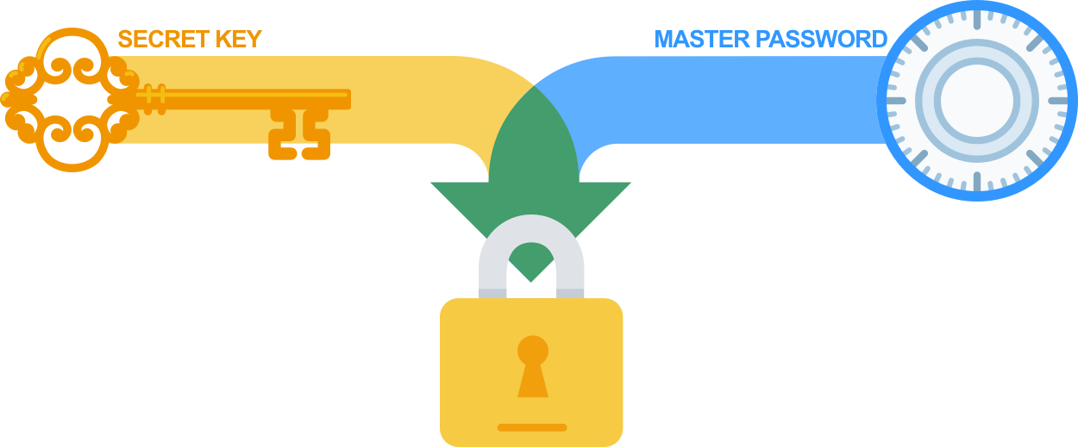
Deriving two keys from two secrets
Two different secrets, each with their own security properties, are used in deriving encryption and authentication keys. In 1Password, these are your account password (something you know) and your Secret Key (a high-entropy secret you have on your device).
Account Password:
Something you must remember and type when unlocking 1Password. It’s never transmitted from your devices.
Secret Key:
A randomly generated user secret key that is created upon first signup. It’s created and stored locally. Along with the user’s account password, it’s required both for decrypting data and for authenticating to the server. The Secret Key prevents an attacker who has acquired remotely stored data from attempting to guess a user’s account password.
PRIVATE AND CONFIDENTIAL
Notes:
Zero-Knowledge Architecture
1Password never knows or stores your Account Password or Secret Key. Without both, vault data cannot be decrypted.
End-to-End Encryption
All decryption happens locally on the user’s device. Encrypted data stored on 1Password’s servers cannot be read by 1Password or attackers.
Two-Key Defense
Vaults are protected by two independent secrets: the Account Password and the Secret Key. This dramatically increases resistance to brute-force and credential-theft attacks.
Granular Item Security
Each vault item is encrypted with its own unique key, limiting blast radius and reducing the impact of any single compromise.

Slide 27
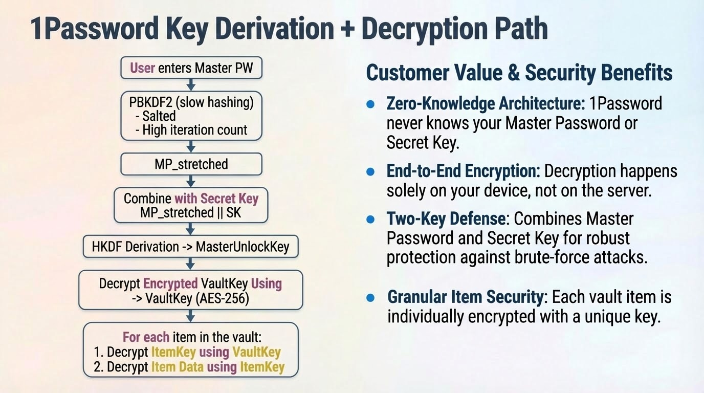
Outcome - reduction of Phishing attacks, reduce risk 1st & last mile, dev secrets visibility time based - human in the loop, autofill, 2MFA, persuasive adoption at LOB, peace of mind knowing gap coverage within budget (not a rip & replace option), scaleable (On / Off boarding), ……..
Notes:
Zero-knowledge design:
1Password never knows your Master Password.
1Password never sees or stores your Secret Key (a 128-bit key unique to your device/account).
These two factors are never transmitted together and never stored in a form 1Password can read.
Even if an attacker breached 1Password’s servers, they would get:
Strongly encrypted vault data
No way to decrypt it
Because only you hold the decryption keys.
AES-256-bit encryption
PBKDF2-HMAC-SHA-256 (with high iteration counts)
SRP (Secure Remote Password protocol) for authentication without sending your password
Locally-derived keys using HKDF
These are all vetted by independent cryptographers and undergo continuous third-party audits.
1Password assumes attackers can compromise everything except your Master Password and Secret Key thus we design encryption so that even catastrophic server or network breaches don’t expose your vault.
From an attacker’s point of view:
Steal the encrypted vault data
Know all salts, algorithms, and parameters
Have the full 1Password source code
They still need:
Correct Master Password (MP)
Correct Secret Key (SK)
Without both, they cannot derive the correct MasterUnlockKey, so they cannot unwrap the VaultKey, so they never get to the item keys or contents.
The Secret Key adds 128 bits of entropy on top of your Master Password, which makes brute forcing essentially impossible in practice.

Slide 28


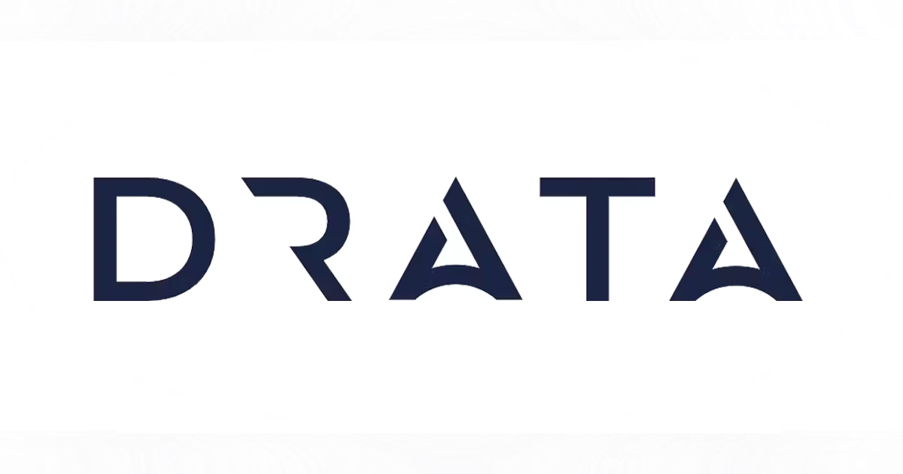

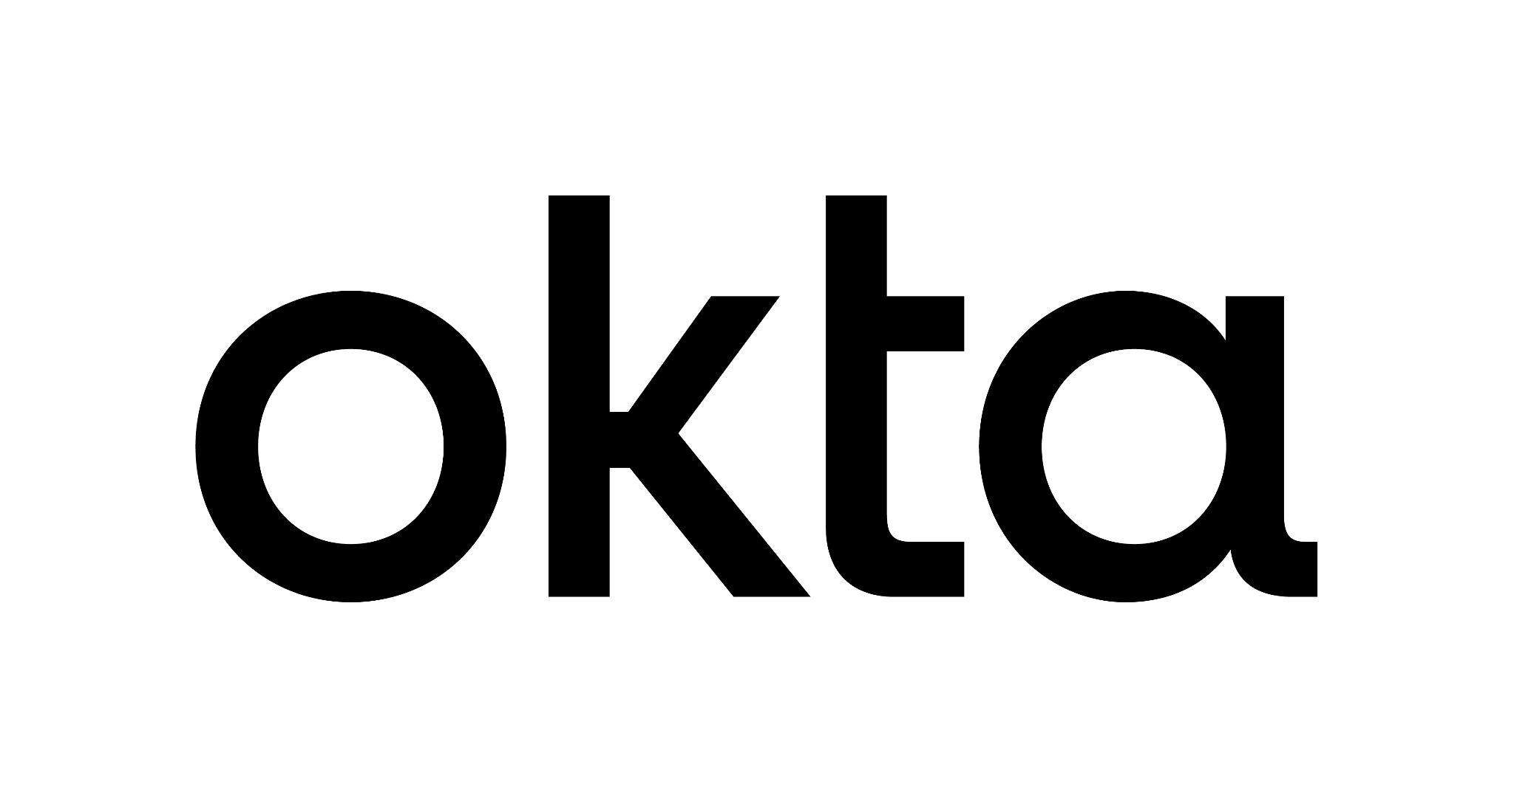


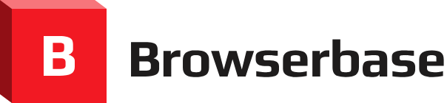

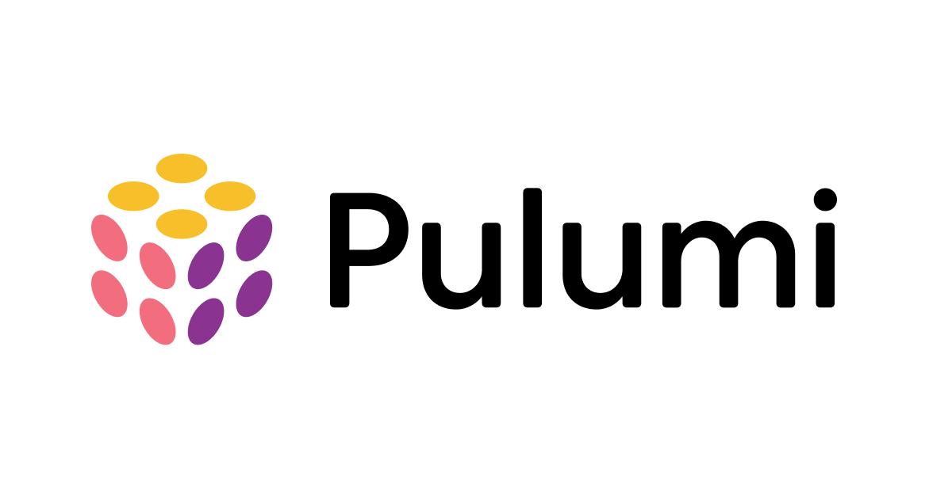























We seamlessly fit into existing tech stacks
More than 350+ integrations with the leading AI, IT and security, and developer tools
AI
IT & Security
Developer
Notes:
1Password integrates with over 350 cybersecurity and IT tools, from Okta to CrowdStrike to Trelica.
We’re not another silo. We’re an enabler that brings your identity, devices, and AI systems together.

Slide 29
Thank you
Please reach out to [email address]
for more info on the demo discussed today.

