Slide 1
1Password for <insert company>
Overview and next steps
Presenter Name, Presenter Title
Date or location

Slide 2
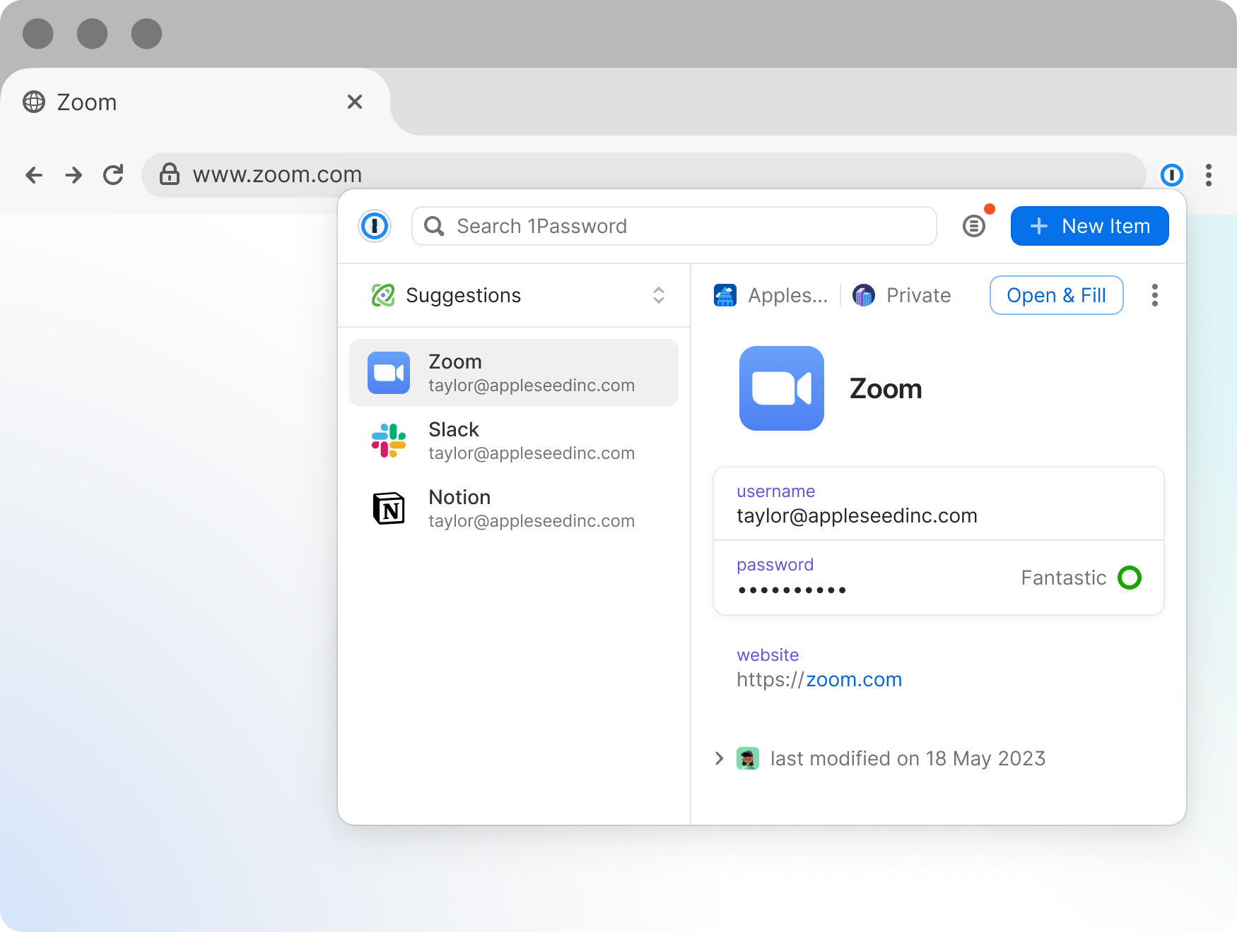
What is 1Password?
Not all password managers are created equal. 1Password is easy to learn, use, and add into daily routines – protecting yourself and your company.
You can securely store, manage, access, and share credentials, documents, and other sensitive information no matter where they are.
<insert company> is implementing 1Password to simplify data security and make it more convenient for everyone to protect and access company data.
1Password Browser Extension with a saved credential
PRIVATE & CONFIDENTIAL

Slide 3
22%
6.9
Save time in your workflows
with 1Password
of time spent on repetitive tasks
22% of an employee’s time is spent on repetitive tasks, with entering passwords and looking for documents as just a few examples.
hours a year saved
1Password saves an employee 6.9 hours a year on average by eliminating time spent resetting passwords, waiting to gain access to systems, or manually entering passwords.
PRIVATE & CONFIDENTIAL
Forrester Consulting: The Total Economic Impact of 1Password Business: based on aggregated 1Password customer interviewee experiences combined into a single composite organization

Slide 4



What you can expect with 1Password
An easy and secure way to save time in your routine
Active threat monitoring and automatic alerts
Industry-leading security
you can rely on
1Password is designed specifically with end users in mind so it’s easy for anyone to quickly learn and use.
It’s simple to save, autofill, and access credentials, documents, and company data to save you more time in daily workflows.
1Password continuously monitors your data for potential security risks or threats with Watchtower.
Get notified of potential threats with automatic, actionable recommendations so you can take charge with a few clicks.
1Password is secure by design, with its unique dual-key encryption, end-to-end encrypted vaults, and their industry vetted secure model.
You can rest easy knowing your information is always secure.
PRIVATE & CONFIDENTIAL

Slide 5
Quick demo
How 1Password looks and feels
PRIVATE & CONFIDENTIAL
Notes:
Click on How 1Password looks and feels to be guided through a demonstration of the 1Password Enterprise Password. Alternatively delete this slide and use slide 6 to insert a demo you have created for your 1Password environment. Additional resource available: MSP Use Product Demo Flow & Talk Track for 1Password Enterprise Password Manager - MSP Edition

Slide 6
<Insert demo video for your 1Password instance>
PRIVATE & CONFIDENTIAL

Slide 7
Next steps & timelines
PRIVATE & CONFIDENTIAL

Slide 8
Next steps & timelines
<Insert next steps employees can expect with the roll out of 1Password>
Should they look out for an email?
Are there instructions they should follow or is there anything to set up beforehand?
Include details about upcoming trainings
PRIVATE & CONFIDENTIAL

Slide 9
Thank you
PRIVATE & CONFIDENTIAL

